Slide 1
KPN Test Automation Framework
©2013, Cognizant

Slide 2
Automation Framework Overview
Automation Framework
Reusable libraries
(Functional +
Support)
Run Manager
Test Results
Driver Script
Test Data

Slide 3
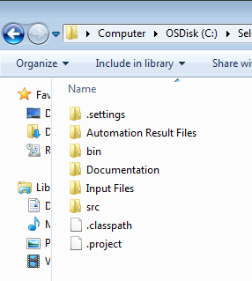
Automation Framework – Folder structure
Result folder contains
date wise result sub-
folders and result file
for each test run
Documentation -
framework
guidelines
Application Libraries
contains the function
libraries
Driver contains main
driver script to be run
to start the execution
Input Files contains
Run Manager,
Datasheet and test
data files

Slide 4
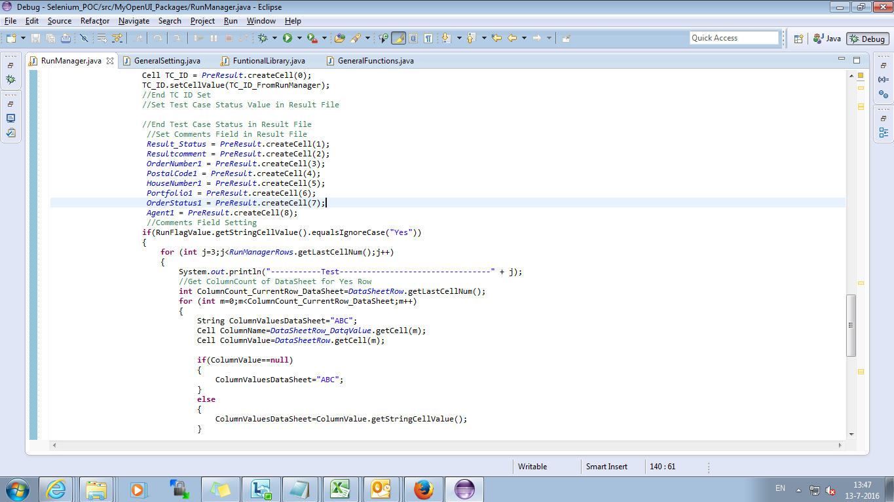
Driver Script – To Run Automation framework

Slide 5
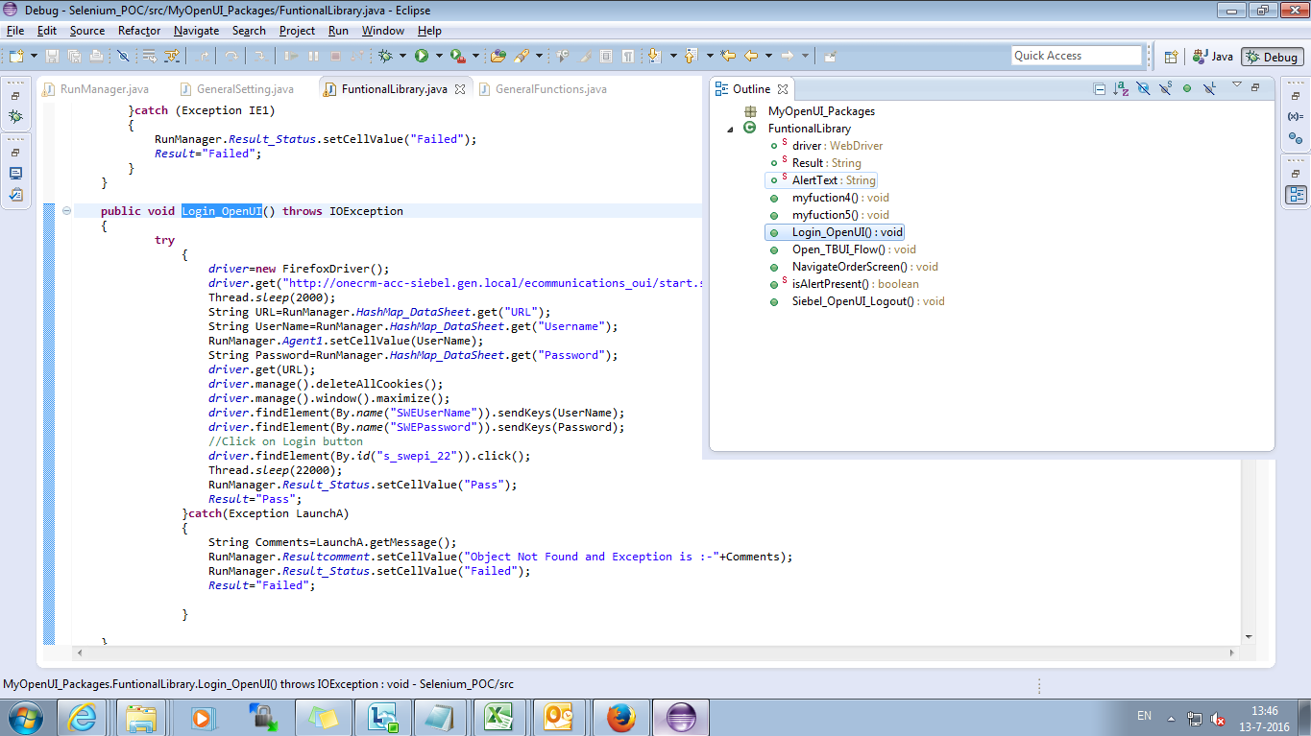
Reusable Function Library – Business component’s

Slide 6
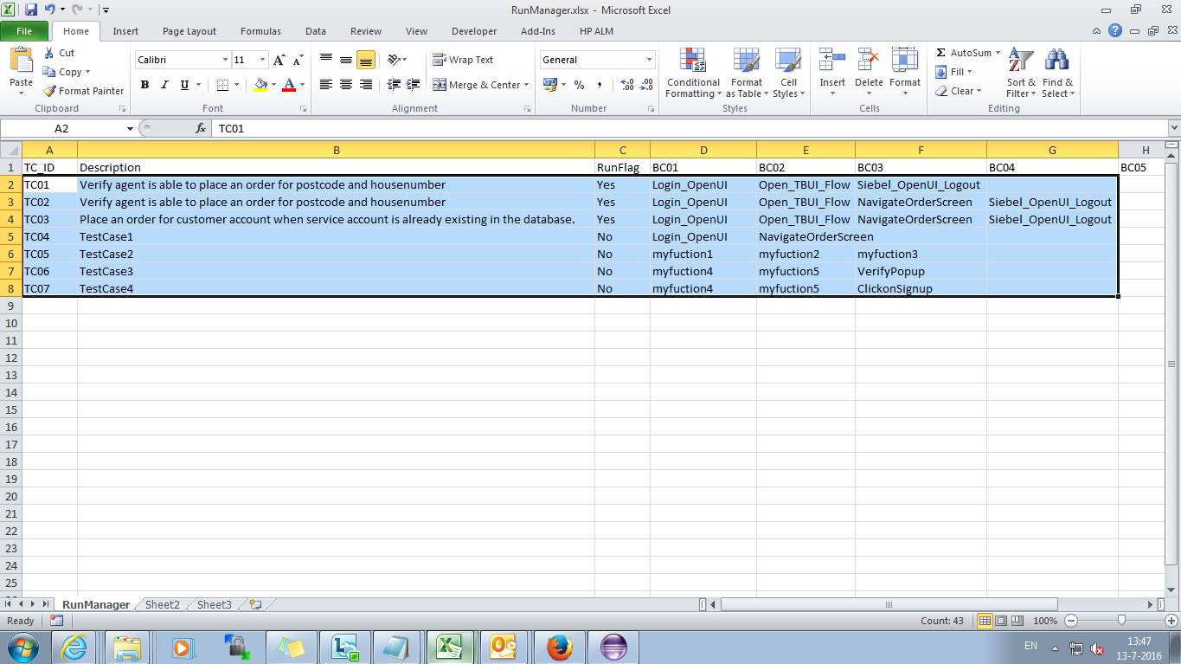
Run Manager – To arrange execution flow

Slide 7
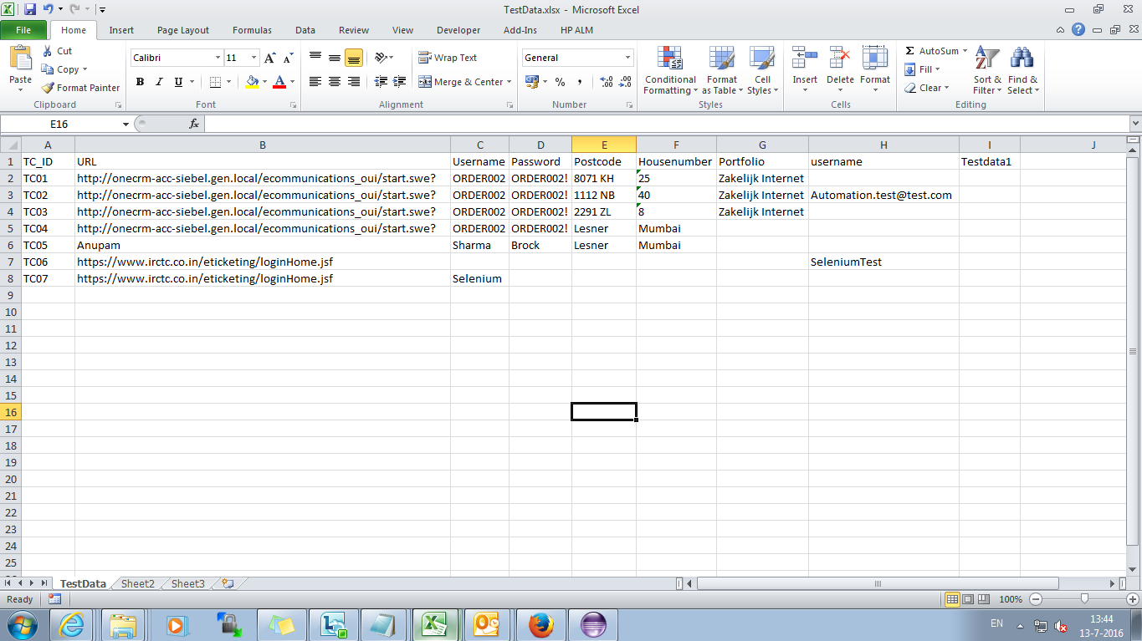
Test Data – To Set up test data for test cases

Slide 8
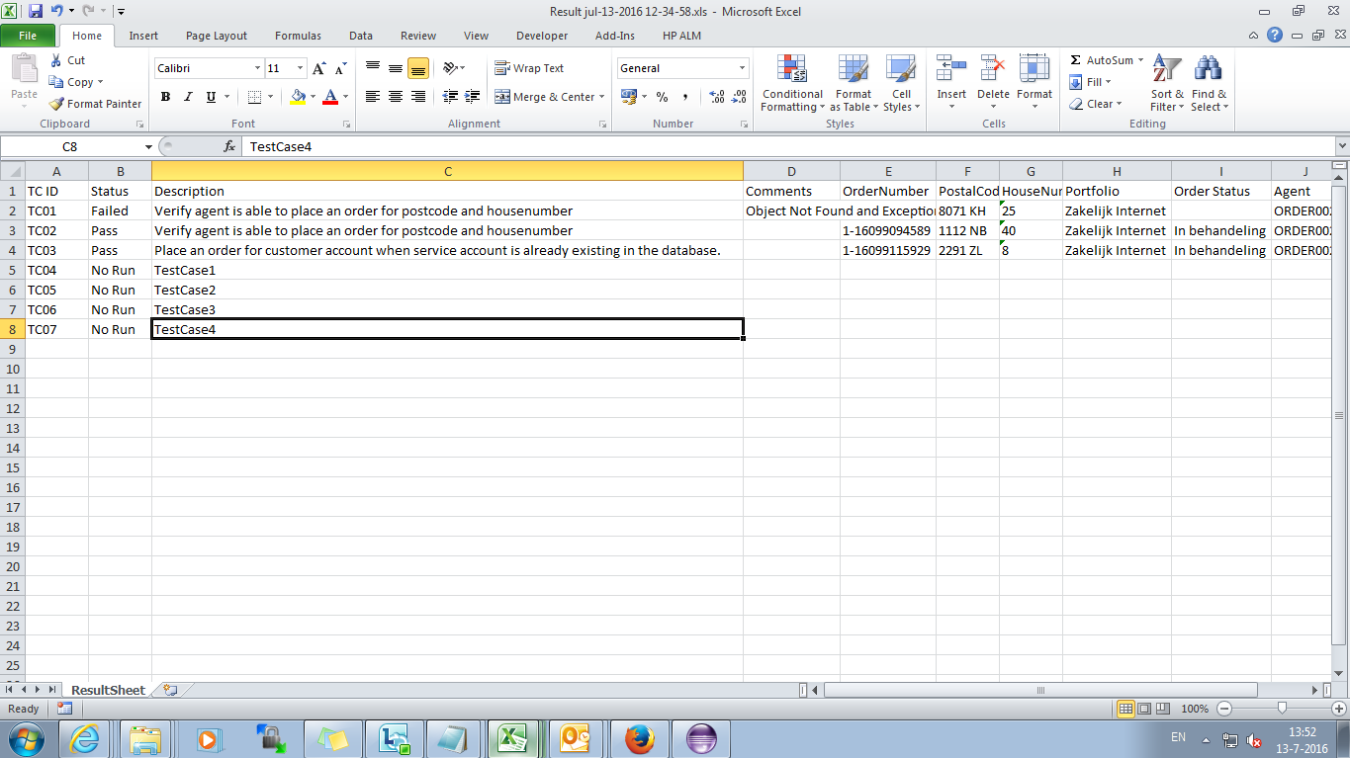
Result – Result File after successful completion of execution

Slide 9
Decision Taken -
Automation Testing in Firefox browser
Team will continue with Firefox browser for automation as KPN policy does not allow to change security setting of Internet explore browser.
Integration of CA Dev Test with Selenium 2.0
The CA Dev Test tool is not feasible with Siebel Open UI Application so, team will continue with Selenium Web driver for automation.

Slide 10
List of Objects captured successfully
Object Name (Siebel Open UI) | Status
Text Box | Pass
Link, Dynamic Link | Pass
Table, row, Column | Pass
Header tab, Child Tabs | Pass
Check box | Pass
Buttons | Pass
MVG | Pass
Dashboard controls | Pass
Model Dialog | Pass
Dropdown list | Pass
Pop Up, Text Editor | Pass

Slide 11
Things to be noted….
Framework provides the basic core framework set-up
Further customization will have to be done as per project specific automation
requirements
Functional library and any additional generic/custom function will have to be
implemented as per automation need for the project

Slide 12
User Manual

Slide 13
Thank You

